Slide 1
AET Then And Now: The History of AET in South Carolina and Current Use of Funds
Michelle Nienhius, MPH, SC Department of Alcohol and Other Drug Abuse Services
Michael George, PhD, Pacific Institute for Research and Evaluation

Slide 2
What we will discuss today
At the conclusion of this workshop, the attendee will:
Know the background of the development and implementation of statewide underage drinking prevention effort through implementation of strategies conducted at the local level .
Understand the South Carolina multi-prong approach to underage drinking issues.
Comprehend how cultural relevance and competency is developed and implemented at the local level in statewide efforts.
Learn about the process and outcome evaluation aspects of AET since 2007.

Slide 3
SAPT Primary Prevention Underage Alcohol Use Goal
Goal: To reduce underage alcohol use in South Carolina.
Objectives:
Decrease past month alcohol use (30 day use) among South Carolina high school students to 26% or less (2017 YRBS-24%)
To reduce the underage alcohol buy rate for the state of South Carolina to 12% or less (FY17 buy rate was 8.6%)

Slide 4
History of Addressing Underage Drinking in South Carolina
(1993) Community Trials research effort led by Dr. Harold Holder, PIRE in Florence, South Carolina.
1
(1998-2002) Enforcing Underage Drinking Laws (EUDL) Block grant funds primarily allocated to colleges to implement campus education programs, alternative events and social norms campaigns. Very little attention paid to Enforcement strategies.
2
(2002-2005) EUDL Discretionary grant -3 SC counties were funded to implement a comprehensive approach to underage drinking prevention based on enforcement, education/awareness and community support (AET Model).
3
(2005-2006) EUDL Block Grant funds used to expand discretionary grant concepts. The sites funded under the discretionary grant became mentor sites to 4 new sites in SC.
4

Slide 5
Funding Resources for Environmental Strategies in South Carolina
The Alcohol Enforcement Team efforts have been funded through a combination of federal (SAPT BG/EUDL BG and EUDL Discretionary grants), state and local funds.
Funding levels have varied from year to year and county to county. Some counties have received federal grants to increase the funding available for AET efforts (NHTSA, DFC, SPF SIG).
The highest level provided by the state was $1,600,000 (2008/2009). This level provided $98,000/circuit.
Current level of funding, $640,000 provided by the state (through federal grants) has remained steady since 2010 (with the exception of one year when it declined to $560,000). This level of funding has provided between $35,000-$50,000/circuit-based on population.
Currently the funds provided by the state are used to support coordination, training and incentives (supplies/materials) for law enforcement partners. Funds provided by the state cannot be used to support officer overtime.

Slide 6
Tragedy brought about change in underage drinking laws in 2007

Slide 7
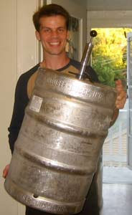
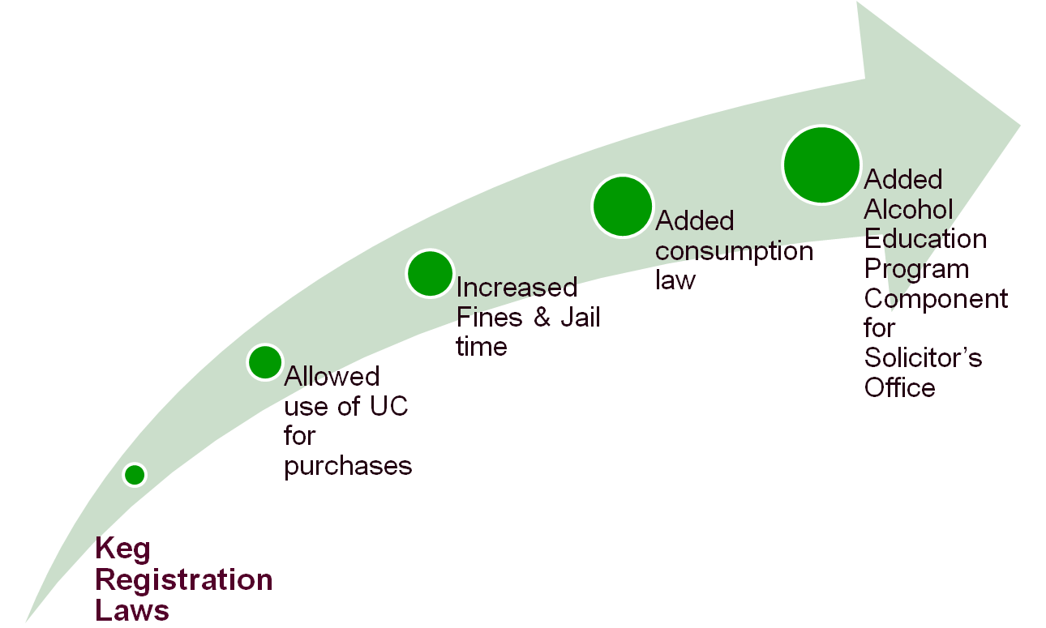
Prevention of Underage Drinking & Access to Alcohol Act of 2007

Slide 8
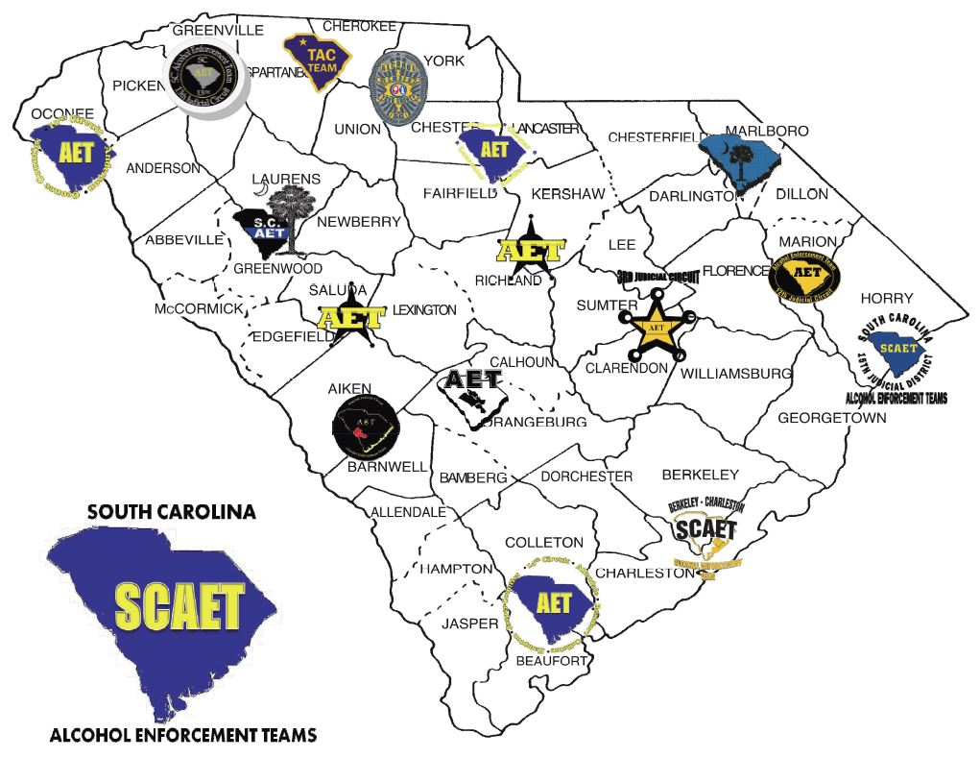
Each Circuit hired a Coordinator
Began extending community relationships and building new ones toward building the teams
All teams formed by October 2007

Slide 9
Additional Efforts to Reduce UAD in SC
Evidence-based programs (Class Act, Life Skills, Project Northland, etc.)
Information Dissemination-Speaking Engagements/Health Fairs
Media Campaigns (messages focusing on education, laws, statistics and enforcement)
PREP (in conjunction with compliance checks)
Alternative Activities (after prom parties, alcohol-free community events)
Youth Board initiatives focusing on UAD through changing peer norms
Policy Change (school, college, business and community)
Alcohol Education (for youth who received MIP)

Slide 10
AET Partnerships & Structure
Alcohol Enforcement Teams
DAODAS
County Alcohol & Drug Agencies
Local law enforcement agencies
AET Coordinators
State AET Liaison
Underage Drinking Action Group (UDAG)
Circuit Solicitor’s Offices
Community Coalitions
Support Activities (AET Training & Media Efforts)

Slide 11
Building Capacity for SCAET
After 5 initial regional AET trainings, requests came in for additional training for expanded topics from 2-day training
Training survey sent statewide in 2010
Began conducting “Training of Trainers” in early 2011 for topics
In early 2011, Fake ID was expanded to 4 hours from 1 hour at initial regional training
Ensured training module containing alcohol trends and fads was added or paired with new training modules

Slide 12
Building capacity for other state and local partners
SC Department of Natural Resources Law enforcement (wildlife officers covering lakes and state hunting areas)
SC Parks, Recreation, and Tourism personnel (state parks)
School Resource Officers Conference
SC Commission on Prosecution Commission training (oversight for Circuit level Solicitors)
SC State Accident Fund (workers compensation for the state)
Military Bases (Air Force & Navy)
Colleges-Resident Hall Advisors/Greek Life
Anywhere we are asked to conduct presentation about underage drinking
Notes:
Anywhere we are asked to conduct presentation about underage drinking…..we add a component discussing alcohol trends & fads

Slide 13
SCAET Class Title | SCCJA Hrs. awarded
Fake and Fraudulent ID Training | 5.0
AET: SC Underage Drinking Laws and Alcohol Products (AET 101) | 3.0
Alcohol Enforcement Team Activities Training | 4.0
Alcohol Enforcement Team Training – Mock Party Dispersal | 4.5
Special Alcohol Events Management Law Enforcement Training | 4.0
AET: Keys to Implementing Effective Environmental Strategies in Local Communities | 12.25, 6.25
Impaired Driving Public Safety Checkpoint Instruction (DVD) | 0.5
PAS Systems Training | 2.0
Source Investigation | 4.0
South Carolina Youth Tobacco Education & Enforcement Training | 2.5
Public Safety Checkpoints: A tool to combat impaired driving in local communities | 4.0

Slide 14
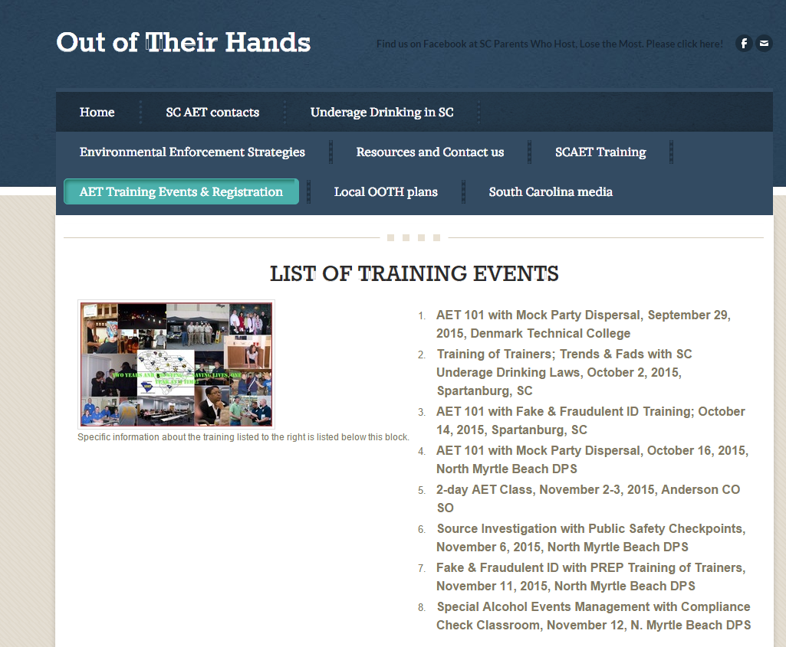
Webpage can be reached at scoutoftheirhands.org

Slide 15
SC Statute Booklet

Slide 16
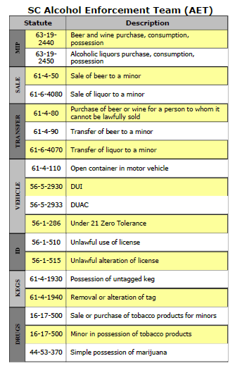
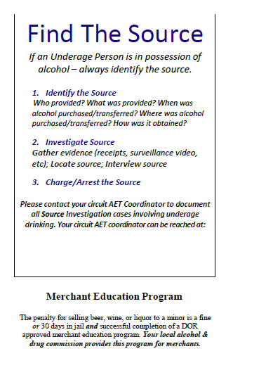
Resource for South Carolina

Slide 17
National Awards were “localized” so that teams across South Carolina received recognition
2011 OJJDP EUDL Leadership Award
June 2014 OJJDP “Success Stories”

Slide 18
AET Requirements for Lead Agency and Other County Agencies
Lead Agency
Hire or contract for an AET Coordinator who will serve all counties in the circuit working with county staff and law enforcement as appropriate
Provide financial and service information to DAODAS
Ensure the circuit is represented at all State Bi-monthly meetings
At a minimum, facilitate quarterly meetings with county prevention directors/staff and law enforcement partners throughout the circuit
Provide documentation to DAODAS the quarterly meetings occurred
Other County Agencies
Support the overall success of the AET and UAD efforts in their counties
Communicate with the AET Coordinator to ensure all AET service data is available and accurately reported in the environmental strategies reporting system, IMPACT and DAODAS
Work with the AET Coordinator to ensure adequate effort in all circuit counties
Agency Prevention Directors/Staff will participate in all AET meetings held in the circuit throughout the fiscal year
Agree to the general direction of the project as outlined in the plan

Slide 19
Allowable & Unallowable Costs for Lead Agency for Circuit
Allowable
Agency staff/contract person salary to include associated cost based on agency's cost allocation plan (fixed charges, office supplies, contractual services, administrative cost, etc.)
Contractual agreements with LE agencies for achieving milestones
Incentives for youth volunteers not to exceed $30.00 in non-cash,
Postage for info dissemination to merchants, parents, local government officials, other LE agencies
Media campaigns (newsletters, newspaper, radio/TV PSA) and printed materials (flyers, brochures, billboards) clearly prevention of underage alcohol use related.
Unallowable
Contractual agreements with LE agencies/agents for time/overtime
Supplies/equipment/materials/apparel even AET-related is not allowable
Media campaigns (newsletters, newspaper, radio/TV PSA) and printed materials (flyers, brochures, billboards) for general prevention or marketing of the agency

Slide 20
Allowable & Unallowable Costs for Other Prevention Agencies in Circuit
Allowable
Office supplies/supplies/media materials used exclusively for AET activities
Postage for info dissemination to merchants, parents, local government officials, other LE agencies
Incentives for youth volunteers not to exceed $30.00 in non-cash
Unallowable
No staff time and other staff-related cost can be charged to the lead agency
No contractual agreements with LE agencies/agents
Supplies/equipment/materials/apparel even AET-related is not allowable

Slide 21
AET MOA’s/Contracts at the local level
DAODAS does not need for the lead agency to submit copies of each MOA/contract for FY19.
These documents will be reviewed as DAODAS comes on financial or programmatic site visits and/or as requested by DAODAS throughout the fiscal year.
Ensure the lead agency has valid agreements in place for both financial and programmatic aspects of the program.
Contracts must be in place if agencies are receiving AET funds
A sample sub-contract shell has been provided to the lead agency from DAODAS

Slide 22
AET Activities-Law Enforcement Partners
Non-reimbursable Environmental Strategies (In-Kind)
Alcohol/Tobacco Compliance checks
Public Safety Checkpoints, Saturation or directed patrol
Underage Party Patrols/Dispersals
Fake ID checks in alcohol establishments
Shoulder Tap Operations
Reimbursable Prevention Activities
Underage Drinking Education/Alive at 25
Alternative Events-alcohol-free community events such as after prom parties, basketball tournaments, etc.
Community Events/Presentations on underage Drinking to community groups, parents, students, etc.
Participation in community groups/meetings to plan prevention activities to reduce underage drinking

Slide 23
Allowable and Unallowable Costs for Law Enforcement Agencies
Allowable
Fee/charge to circuit lead agency for achieving and documenting milestones. These funds can then be used as follow:
Advanced training for officers on implementing evidence-based environmental strategies to reduce underage drinking
Media materials related to the prevention of underage alcohol use (e.g. billboards, radio and TV ads, flyers, buttons, etc.)
Provide trainings/conferences related to implementing best practice environmental strategies aimed at reducing underage drinking
Officers time for prevention activities that are not enforcement:
Working with the media, providing public presentations/ information dissemination, train other officers on how to conduct effective environmental strategy enforcement operations to reduce underage drinking, etc.), teaching educational programs, participating in community-based process activities and alternative events.
Training of LE personnel:
Monthly workshops, quarterly training, national trainings-Northwest Alcohol Conference, Life Savers, etc., SC Highway Safety Conference, DAODAS/SCAPPA trainings
Speaker fees
Room rental
Materials/handouts
Alternative event activities related to underage drinking prevention:
(e.g. after prom, community events, fairs, etc.)
Unallowable
Time/overtime payments for LE agents to perform law enforcement activities
Supplies/equipment/materials/apparel even AET-related is not allowable

Slide 24
Outcomes in Reducing Underage Drinking in SC

Slide 25
SAPT Primary Prevention Underage Alcohol Use Goal
Goal: To reduce underage alcohol use in South Carolina.
Objectives:
Decrease past month alcohol use (30 day use) among South Carolina high school students to 26% or less (2017 YRBS-25.4%)
To reduce the underage alcohol buy rate for the state of South Carolina to 12% or less (FY17 buy rate was 8%)

Slide 26
Outcomes for SC in Reducing Underage Drinking
Survey Item | 2005 | 2017 | % decrease
high school students reported ever drinking alcohol | 71.1% | 57.4% | -19.3%
reported drinking alcohol before age 13 | 25.6% | 15.2% | -40.6%
reported drinking alcohol in past 30 days | 43.2% | 24.0% | -44.4%
reported binge drinking (5 or more drinks in 2 hour time period) in past 30 days | 23.6% | 10.4% | -55.9%

Slide 27
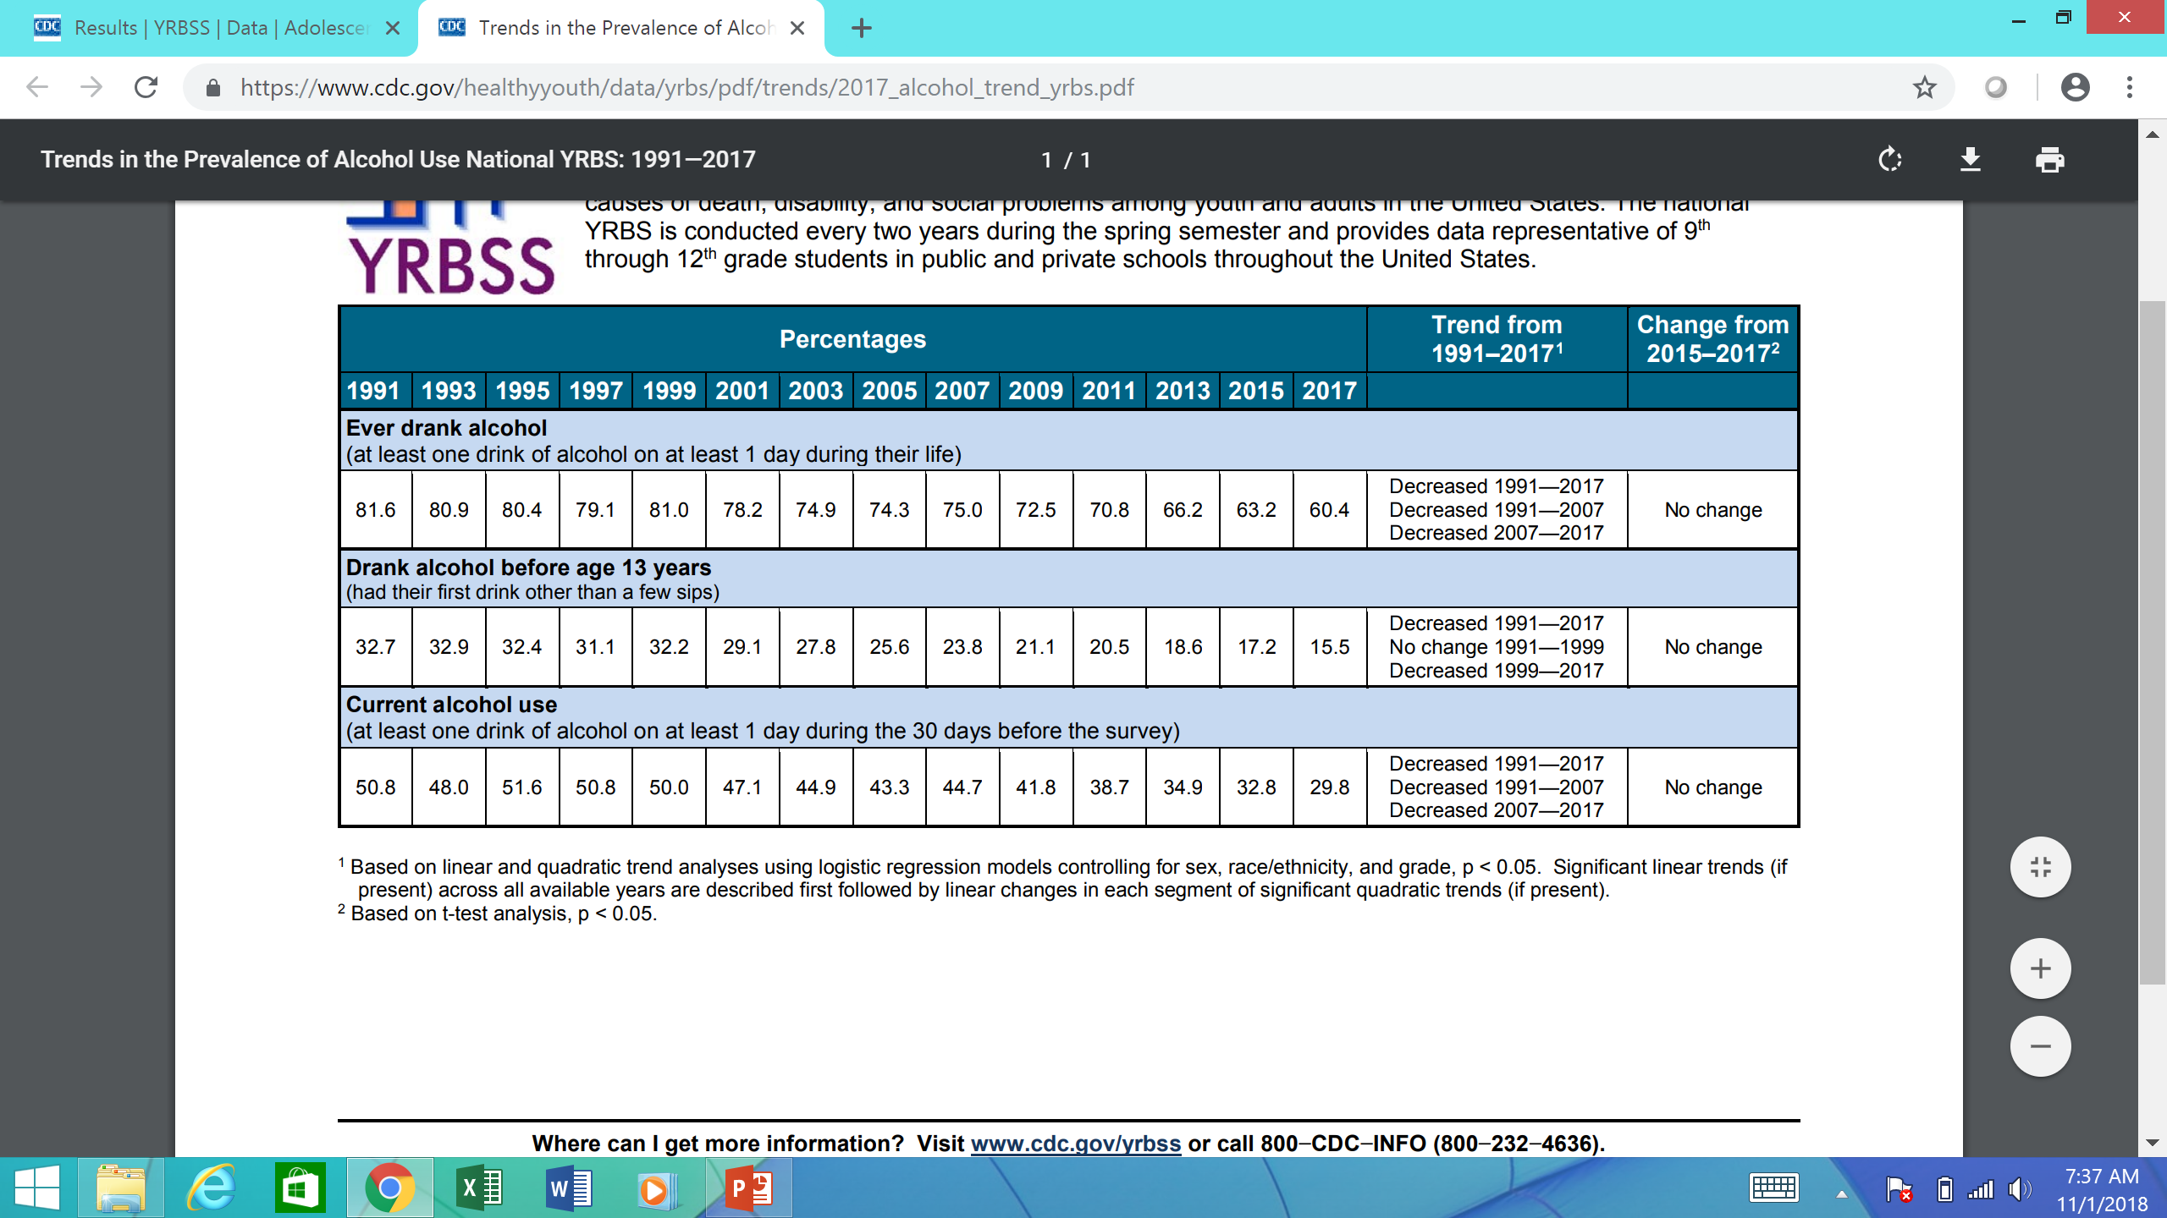

Slide 28
Training held in 43 of 46 SC counties since 2007
Training Topic | # of Participants | # of Officers | # of Youth Actors
3-hour AET Class | 1035 | 591 | 79
AET Activities | 428 | 366 | 315
1-Day AET | 164 | 151 | 72
Fake ID Training | 702 | 627 | 161
Mock Party Dispersal | 139 | 135 | 107
PAS Systems | 324 | 307 | 0
Public Safety Checkpoints | 284 | 261 | 0
Source Investigation | 214 | 185 | 0
2-Day AET | 840 | 757 | 476
Various Topics | 527 | 387 | 0
Totals | 4,668 | 3,776 | 1,222
Notes:
Calhoun, Hampton, Oconee

Slide 29
Success Stories for AET Training
SLED agents confiscated fake IDs after attending Fake ID class & Laurens CO SO used knowledge learned to identify Fake IDs on traffic stop
Lancaster CO SO deputies used Controlled Party Dispersal training to gain entry on underage party
Military officers used information from Trends & Fads training for barracks inspections
PAS Vr training for Edisto River collaboration between Colleton CO SO & Dorchester CO SO

Slide 30
AET Operations
Compliance checks
Saturation or directed patrol
Regular traffic stops
Loud music complaints
Casual contacts
School Resource Officers
Presentations to community groups, political bodies, parents, students, etc.
Fake ID checks in alcohol establishments

Slide 31
FY2008 – FY2017 Enforcement Numbers * July 1, 2007 through June 30, 2017 (state fiscal years run July 1 to June 30)
Activity | FY2008-2017 | Activity | FY2008-2017
Compliance Checks | 73,943 | Compliance Check Sales | 9,781
Public Safety Checkpoints | 7,477 | Bar checks | 2,901
Saturation Patrols | 2,620 | # of Parties Prevented | 1,522
Party Dispersals | 1,395 | Merchant Education | 16,514
Media Contacts | 2,995 | Shoulder Taps | 313
** Enforcement & Education numbers are collected monthly but FY 2018 numbers are not included in this count

Slide 32
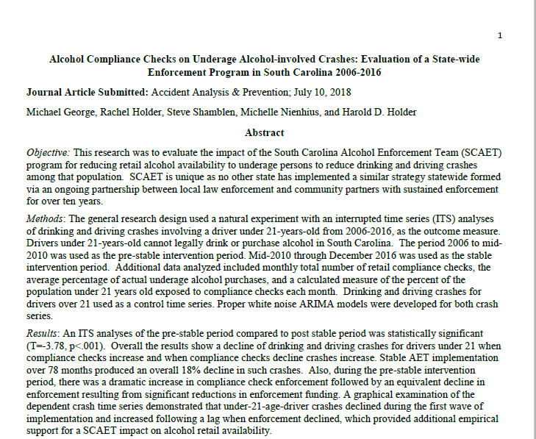
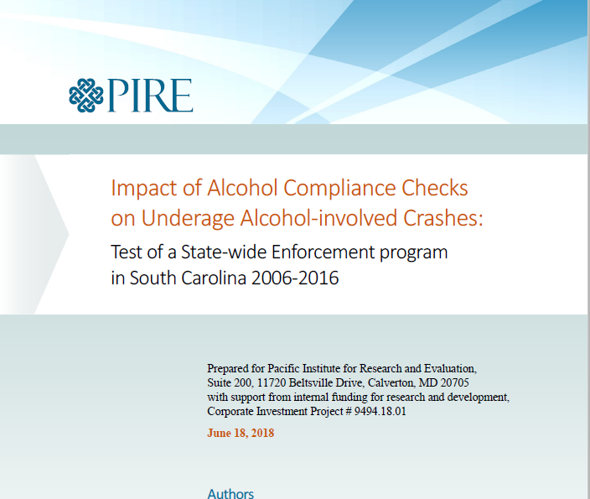
Alcohol Compliance Checks on Underage Alcohol-involved Crashes: Evaluation of a State-wide Enforcement Program in South Carolina 2006-2016

Slide 33
Underage Drinking Logic Model of Change
Increased compliance checks
01
Less underage drinking
03
Reduction of Retail sale of alcohol to underage persons (reduced alcohol access)
02
Less drinking & driving crashes by underage drivers
04

Slide 34
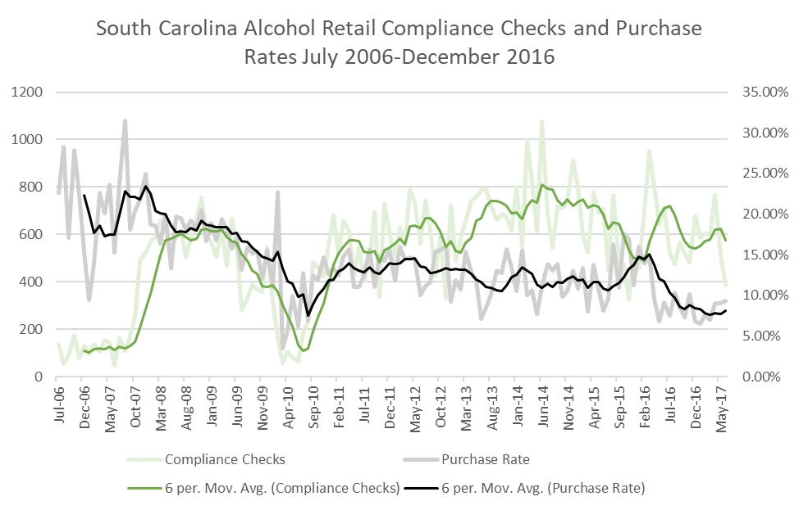

Slide 35
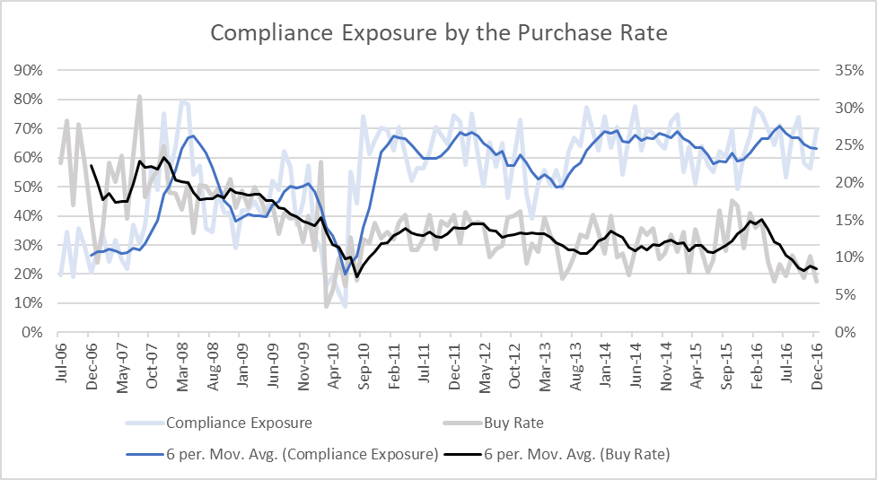

Slide 36
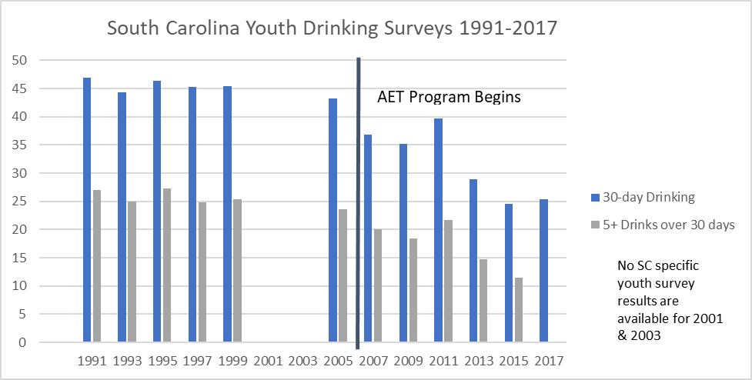

Slide 37
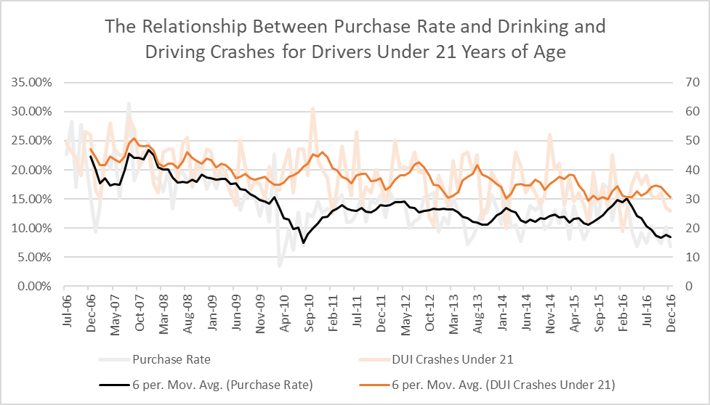

Slide 38
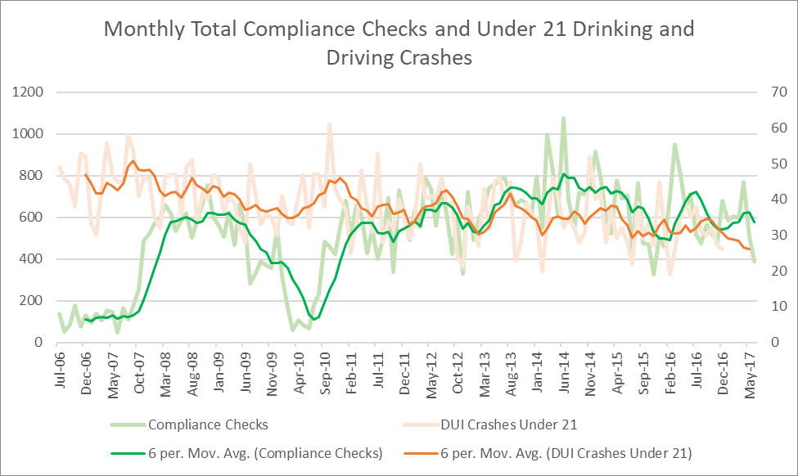

Slide 39
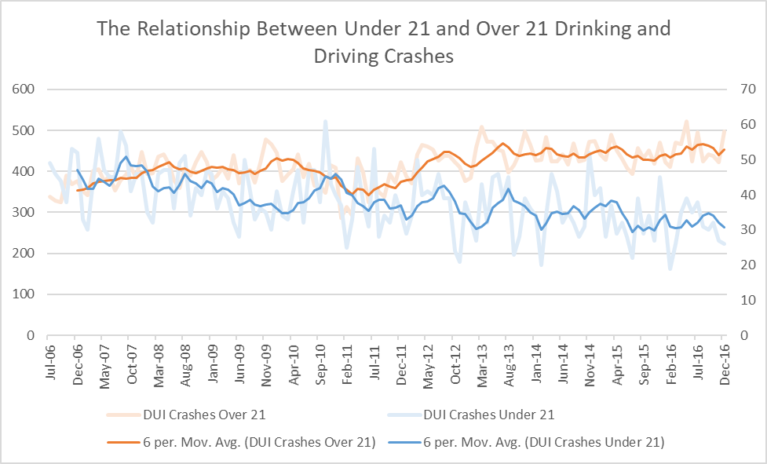

Slide 40
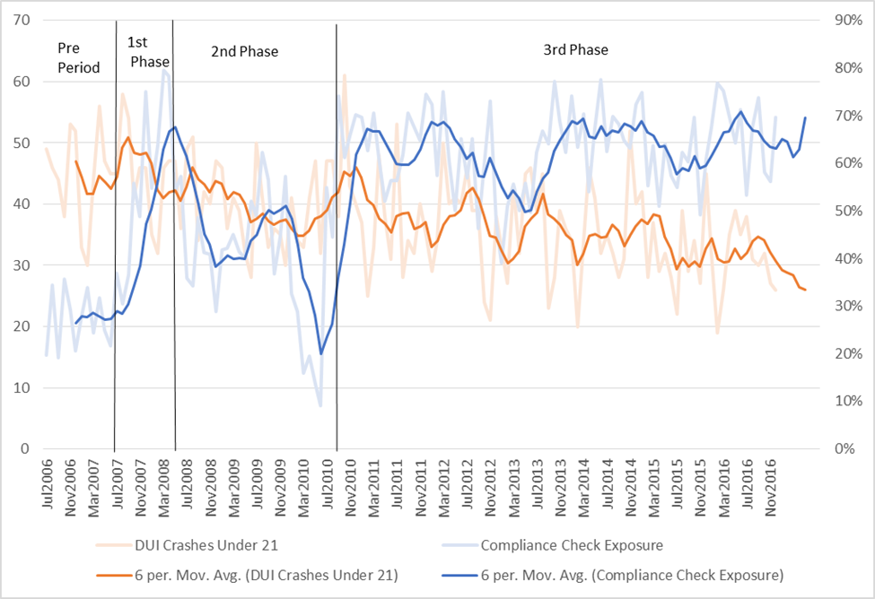

Slide 41
Results and Conclusions
Continued alcohol compliance checks achieved reduction in buy rate which ultimately had a part to play in reductions in impaired driving traffic crashes
Buy rate reduced from 25% (2005) to 8.6% (2016) = 60% reduction – Preliminary results for FY 2018 = 6.9% or -72.4%
Impaired driving traffic crashes for > 21 year-olds decreased in 2010 through 2016
Strong downward trend in YRBS (past 30-day use, lifetime use, & binge drinking) followed after AET implementation
Current study provides strong empirical confirmatory evidence that MDLA is dependent on continued enforcement & advocacy for statewide underage drinking program with local emphasis

Slide 42
Limitations for study
South Carolina is private licensing state for off-premise alcohol sales. The same results may not occur in states with government operated alcohol outlets
While study confirms need for “consistent & regular” enforcement of retail alcohol availability, dosage for compliance checks is not known
It is not known how much statewide AET impacted underage drinking. Other factors exist (programs such as Alive @ 25 & traffic enforcement through SCLEN).
Possible two or more state research involving specific counties in each state

Slide 43
Environmental Prevention Strategies Reporting System
Focus is on environmental strategies involving law enforcement: compliance checks, sobriety checkpoints, bar checks, party dispersals, shoulder taps.
Operations-level data (nearly 10,000 operations per year).
Replaced a paper-pencil reporting system (mailing, scanning, cleaning, and high lag-time).
Completed by law enforcement officers in the field or by AET Coordinators at their offices.
Real-time reports available at the state, circuit, and county levels.
Launched in July of 2016
Reboot scheduled for October of 2018, with user-friendly filtering and reporting.

Slide 44
New Training Topics-Coming Soon in SC
Creating Environmental Change in Communities on Alcohol –Winter 2019
Electronic Cigarettes/Vaporizing Devices: New fads and trends, SC laws, youth use data, etc.
Marijuana: New fads and trends, SC laws, youth use data, etc.

Slide 45
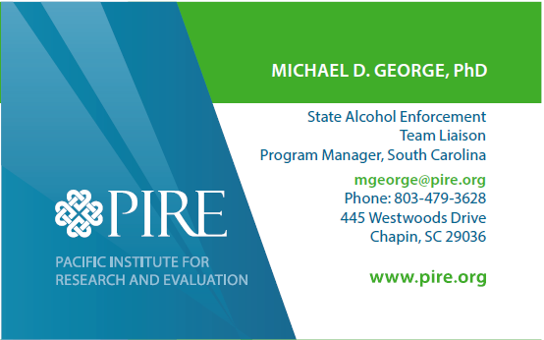
Questions?
Michelle M. Nienhius, MPH
Michael D. George, PhD

